Slide 1
Web & REST API Security
Best Practices

Slide 2
Use TLS
If your app deals with or transmits sensitive data, use Transport Layer Security (TLS) to secure the connection and the data. This technology encrypts data before it is sent from the client to the server, thus preventing some common (and easy) hacks.

Slide 3
Use Helmet
Helmet can help protect your app from some well-known web vulnerabilities by setting HTTP headers appropriately.
$ npm install --save helmet

Slide 4
Reduce Fingerprinting
It can help to provide an extra layer of obsecurity to reduce server fingerprinting. Though not a security issue itself, a method to improve the overall posture of a web server is to take measures to reduce the ability to fingerprint the software being used on the server. Server software can be fingerprinted by kwirks in how they respond to specific requests.
app.disable('x-powered-by')

Slide 5
Use cookies securely
To ensure cookies don’t open your app to exploits, don’t use the default session cookie name and set cookie security options appropriately.

Slide 6
Don’t use the default session cookie name
const session = require('express-session') app.set('trust proxy', 1) // trust first proxy
app.use(session({
secret: 's3Cur3',
name: 'sessionId' }))

Slide 7
Set cookie security options
Set the following cookie options to enhance security:
secure - Ensures the browser only sends the cookie over HTTPS.
httpOnly - Ensures the cookie is sent only over HTTP(S), not client JavaScript, helping to protect against cross-site scripting attacks.
domain - indicates the domain of the cookie; use it to compare against the domain of the server in which the URL is being requested. If they match, then check the path attribute next.
path - indicates the path of the cookie; use it to compare against the request path. If this and domain match, then send the cookie in the request.
expires - use to set expiration date for persistent cookies.

Slide 8
Prevent brute-force attacks against authorization
Make sure login endpoints are protected to make private data more secure.
A simple and powerful technique is to block authorization attempts using two metrics:
The first is number of consecutive failed attempts by the same user name and IP address.
The second is number of failed attempts from an IP address over some long period of time. For example, block an IP address if it makes 100 failed attempts in one day.
rate-limiter-flexible package provides tools to make this technique easy and fast

Slide 9
Ensure your dependencies are secure
You can use ‘npm audit’ to analyze your dependency tree.
$ npm audit
Snyk offers both a command-line tool and a Github integration that checks your application against Snyk’s open source vulnerability database for any known vulnerabilities in your dependencies. Install the CLI as follows:
$ npm install -g snyk
$ cd your-app
Use this command to test your application for vulnerabilities:
$ snyk test
Use this command to open a wizard that walks you through the process of applying updates or patches to fix the vulnerabilities that were found:
$ snyk wizard

Slide 10
Additional considerations
Always filter and sanitize user input to protect against cross-site scripting (XSS) and command injection attacks.
Defend against SQL injection attacks by using parameterized queries or prepared statements.
Use the open-source sqlmap tool to detect SQL injection vulnerabilities in your app.
Use the nmap and sslyze tools to test the configuration of your SSL ciphers, keys, and renegotiation as well as the validity of your certificate.
Use safe-regex to ensure your regular expressions are not susceptible to regular expression denial of service attacks.

Slide 11
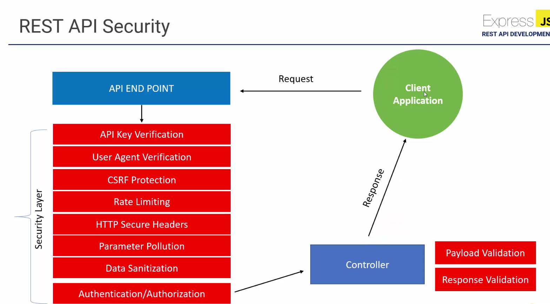
REST API Security

Slide 12
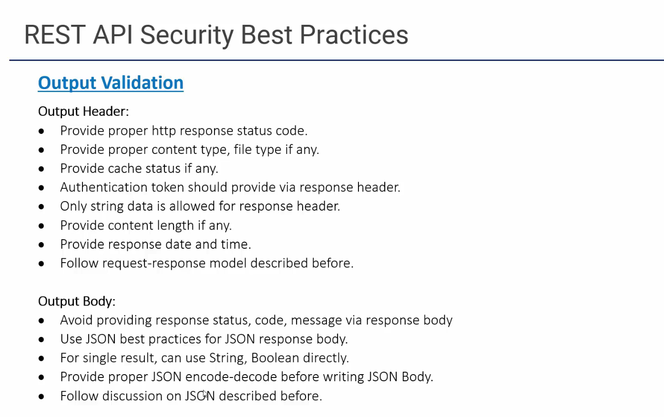

Slide 13
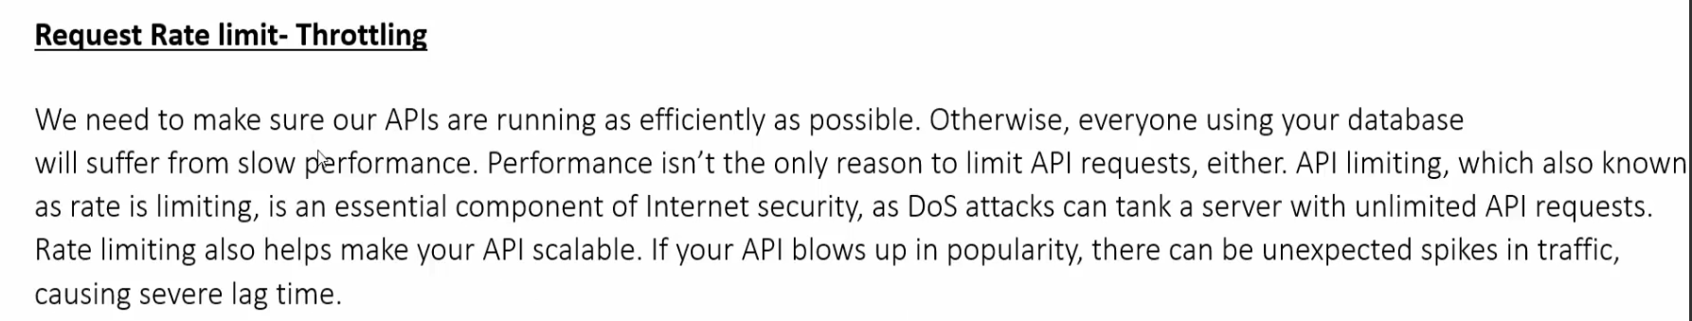
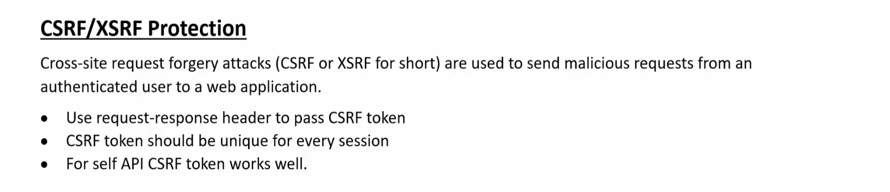
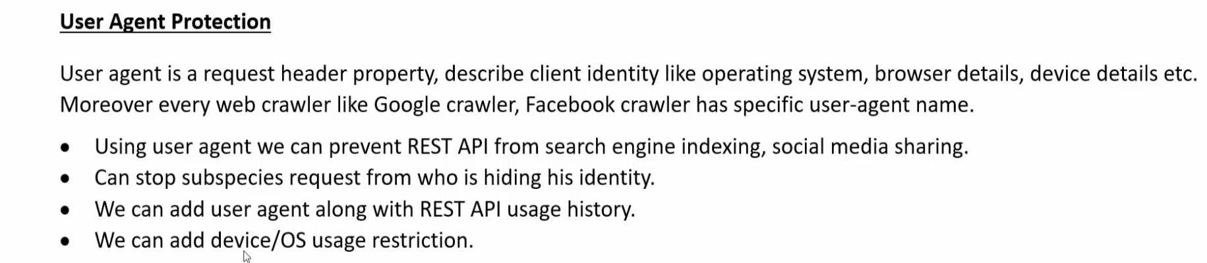

Slide 14
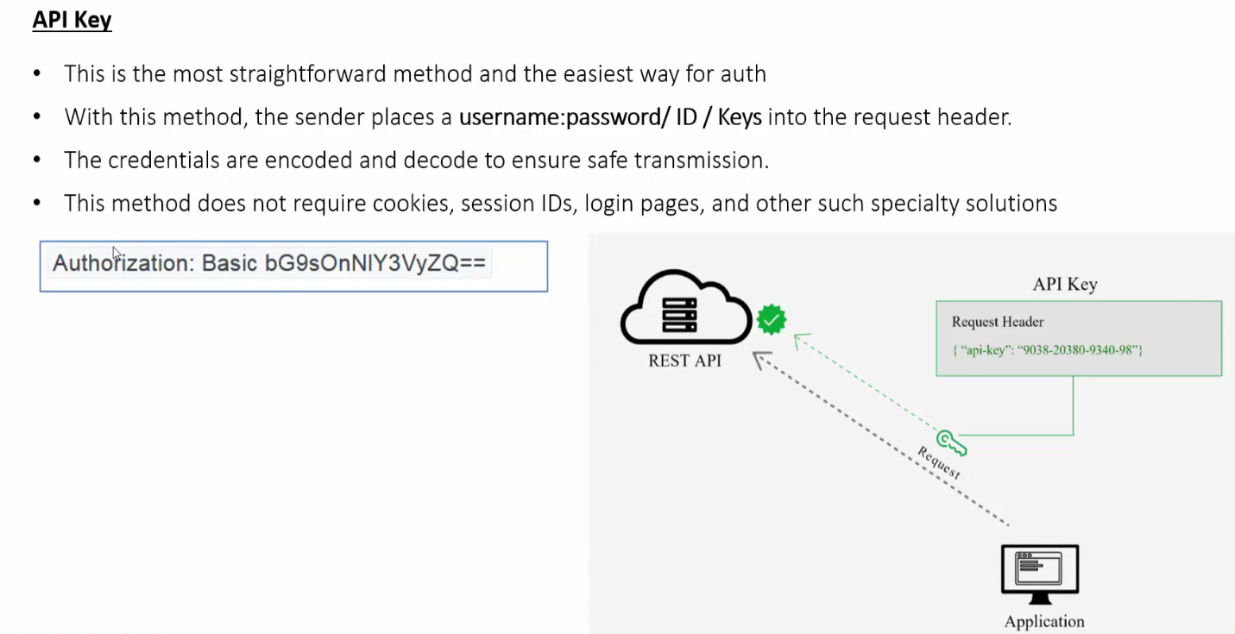
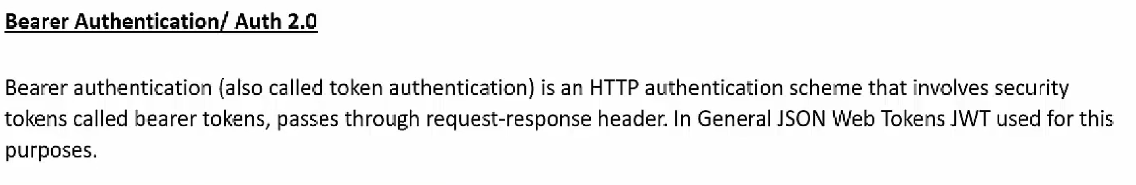

Slide 15
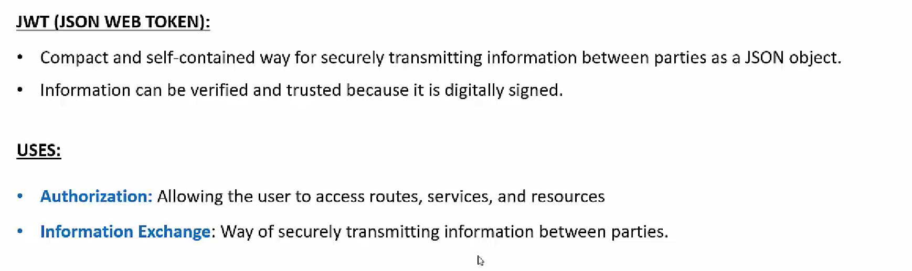
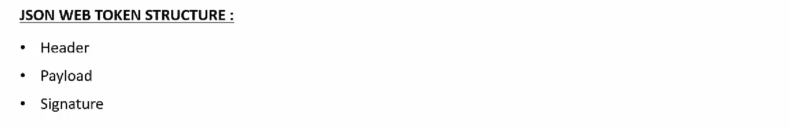
JSON WEB TOKEN (JWT)

Slide 16
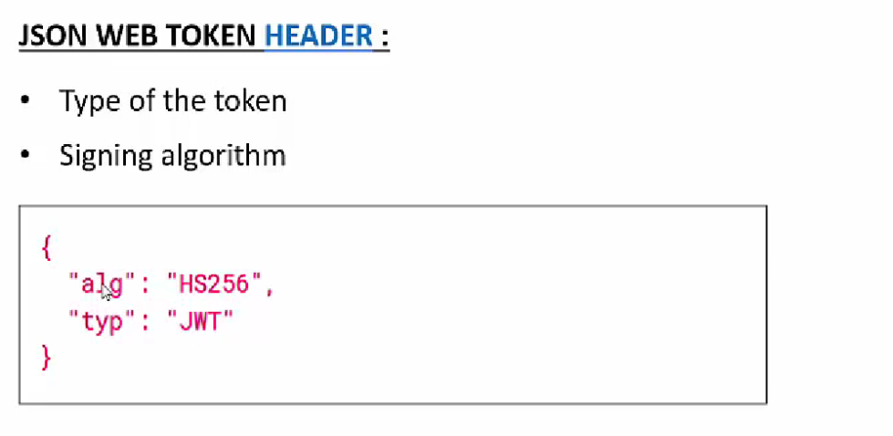
JSON WEB TOKEN HEADER

Slide 17
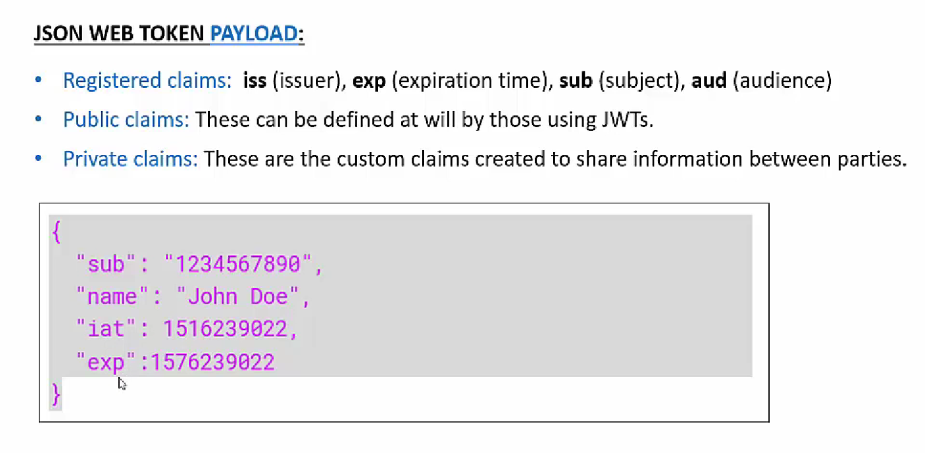
JSON WEB TOKEN PAYLOAD

Slide 18
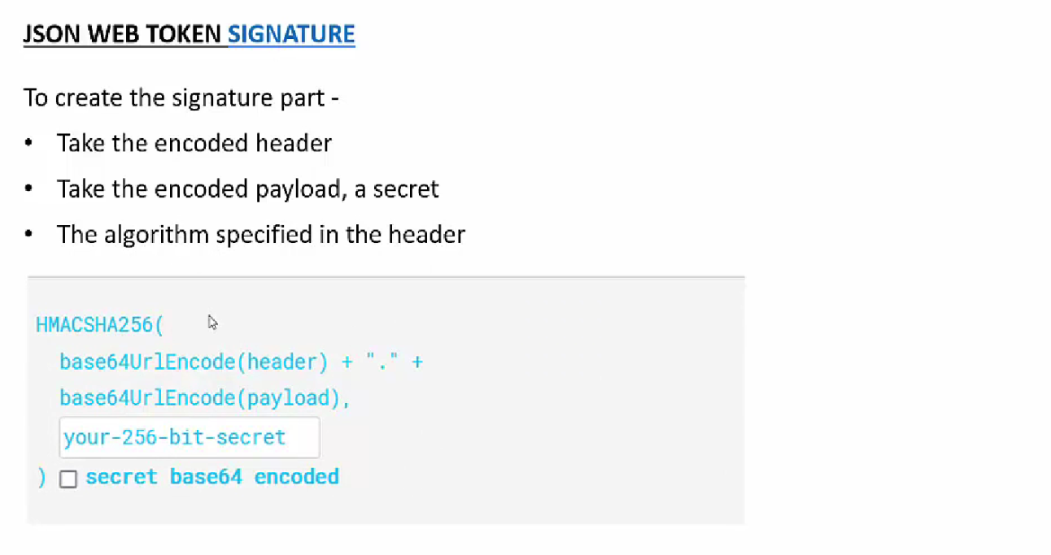
JSON WEB TOKEN SIGNATURE

Slide 19
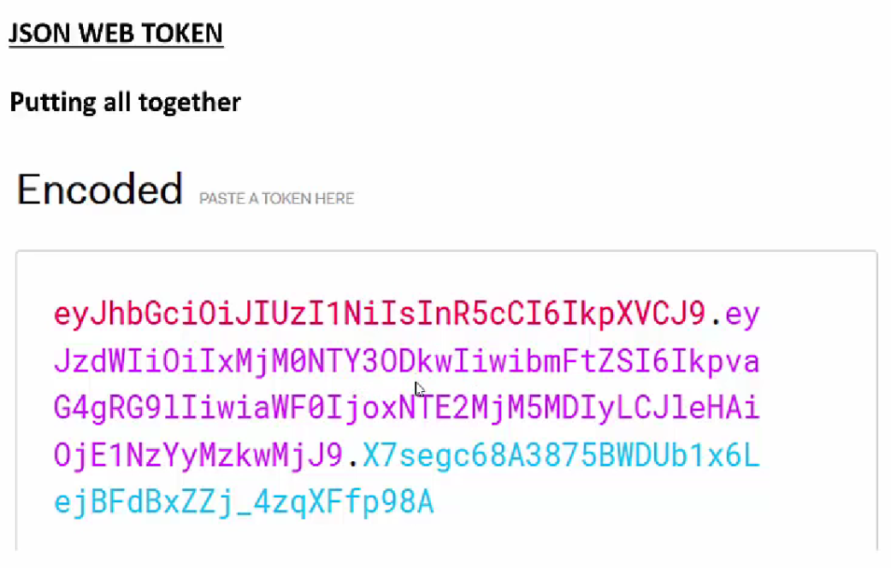
JWT

